Slide 1
Data Science Mini Project On League Of Legends
CSPT 1
Estela Yar Raj Almendras
Elias Chang Rui Yuan
Brandon Voon Yen Seng
Notes:
Hello professors and teacher assistants, I am Brandon, together with me are Raj and Elias. We will be presenting on the work we have done for the mini project and the topic we are covering is league of legends.

Slide 2
Table Of Contents
Introduction
Problem Definitions
Data Preparation and Cleaning
Exploratory Data Analysis
Problem Definition #1
Problem Definition #2
Machine Learning Model
Problem Definition #3
Machine Learning Model
Conclusion
Notes:
We will be going through the introduction, problem definitions, data preparation and cleaning, as well as EDA, and finally the conclusion.

Slide 3
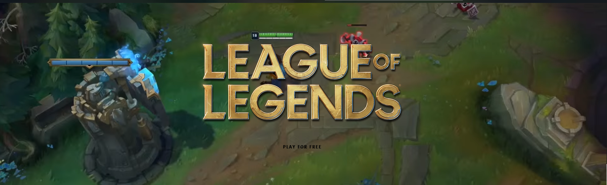
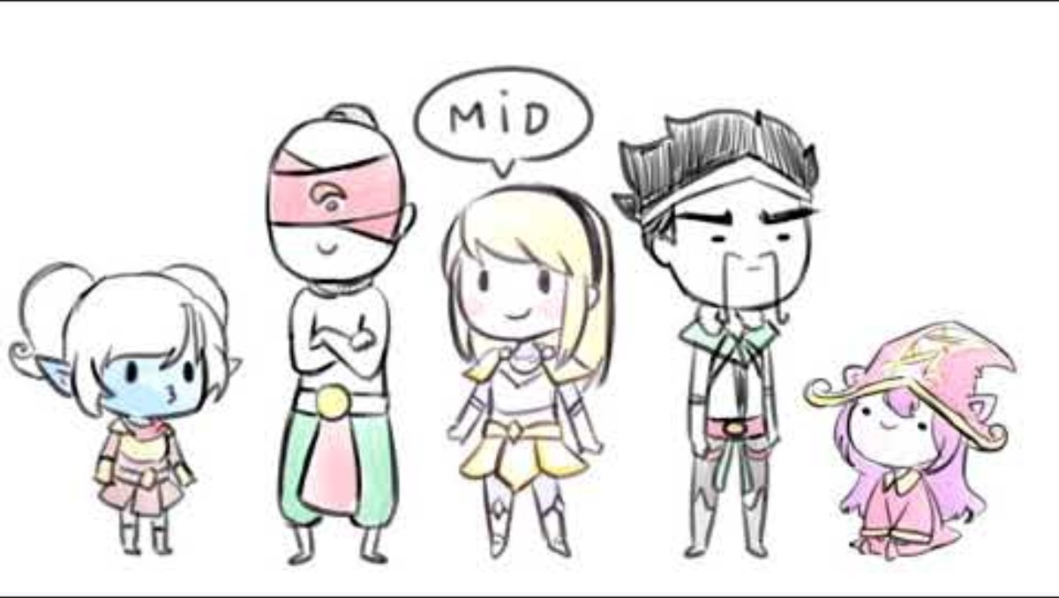
League Of Legend Introduction
League of Legends (LoL) is one of the most popular online games worldwide, boasting millions of players.
5v5 multiplayer online battle arena (MOBA), where teams fight against each other in a virtual battlefield called the Summoners Rift.
It is a strategic game that demands teamwork, skill, and adaptability.
Notes:
But first, we would like to briefly explain to you what is league of legends.
It is a multiplayer online battle arena video game where the primary objective is to destroy the base of the other team, and each team consist of 5 champions. You may watch this short video to gain a better understanding of the game. For this presentation, we will skip the video due to time constraint.

Slide 4
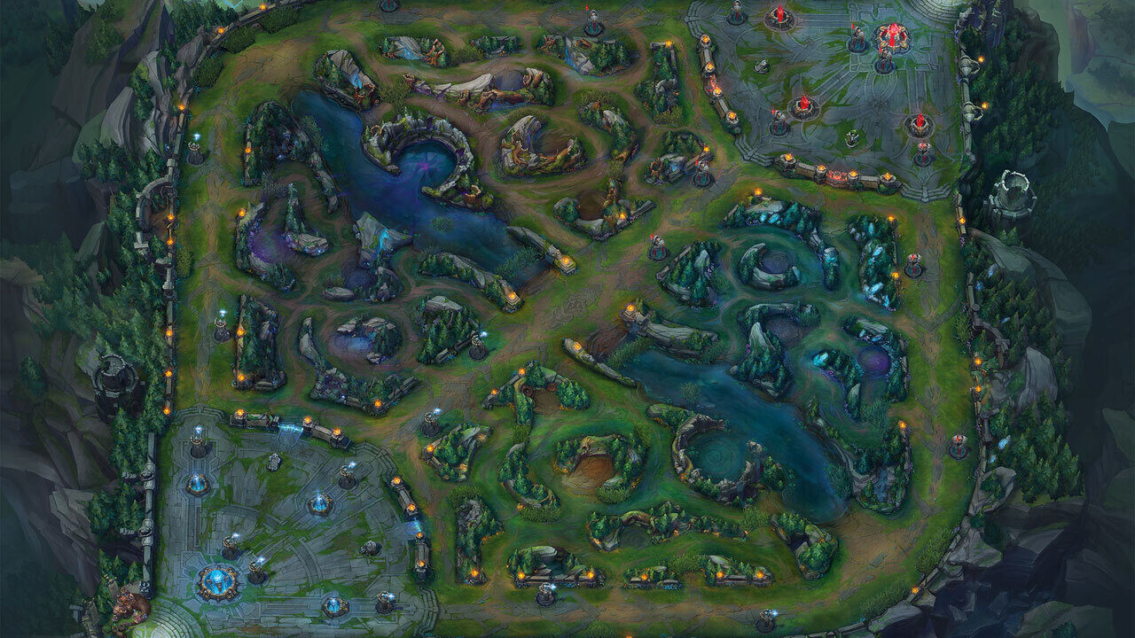
Summoners Rift
Top
Team 2
Jungle
Mid
Jungle
Team 1
Bot & Support
Notes:
And this is a map where the battle happens, with the bases of the 2 team’s at the top right and bottom left, and there are also the top, middle, bottom & support and jungle positions. The positions are important as different champions at different position will greatly affect the outcome of the match.

Slide 5






Champions, Roles & Positions
Mage
Composed of 5 unique champions (characters) per team
Each player controls a champion
Champions are a diverse set characters with their own set of abilities, strengths, weaknesses and classes
These are some examples of the champion classes
Support
Warrior
Tank
Assassin
Marksmen
Notes:
As mentioned before, each player controls a champion and these champions are classified into different roles such as mage and warrior, with each fulfilling a specific role within a team.

Slide 6
Problem Definition
Analyze official competitive matches and identify the best champion class combination that will result in a win.
What is the most optimal and suitable game variable in predicting the total combined gold value? Amongst these variables Total kills, Total minion score, Neutral Objectives and Structures taken down
Can we accurately predict the outcome of the match? Based on team compositions, total gold earned, kill score, creep scores, neutral objectives score, and structures taken score.
Notes:
Moving on, we would like to talk about the problem definitions of our mini project.
The first problem definition is to identify the best champion class combination that will result in a win.
Second is to predict the total gold based on other variables.
Follow by predicting the outcome based on team combination, total gold and other variables.

Slide 7
Data Preparation and Cleaning
Dataset 1 - 2024_LoL_esports_match_data_from_OraclesElixir_gamedata.csv
1023 rows × 779 columns
Source
https://www.kaggle.com/datasets/barthetur/league-of-legends-2024-competitive-game-dataset
clean
Columns required for Problem Definition #1 #2 and #3
clean_match_data
Notes:
Before we start the EDA of our problem definition, we need to prepare and clean the datasets, which we needed 2 datasets for our problem definitions.
This is the first dataset which contains all the data of the official competition.
And as you can see, there are more than 700 columns, so we must drop the columns that are not useful for our problem definitions.

Slide 8
Data Preparation and Cleaning
Dataset 2 - LoL-Champions.csv
167 rows × 11 columns
Source
https://www.kaggle.com/datasets/uskeche/leauge-of-legends-champions-dataset
clean
Name and Class columns to supplement dataset 1
clean_champion_data
Notes:
This is the second dataset and this dataset will supplement the first dataset as it contains the champions’ data like name and class, which the champion's class is what we interested in for our EDA.

Slide 9
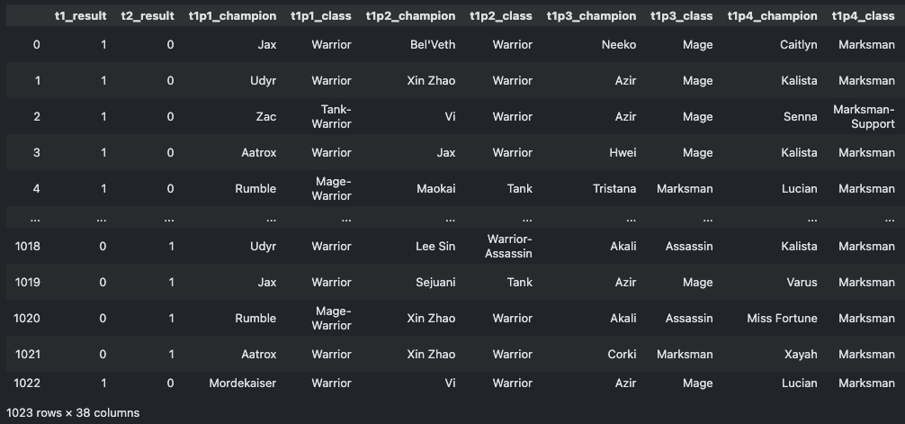
Data Preparation and Cleaning
Dataset 1 - clean_match_data
Dataset 2 - clean_champion_data
merge
cleaned_data
Notes:
Then finally, we merged the data into a clean dataset that we used for our EDA.

Slide 10
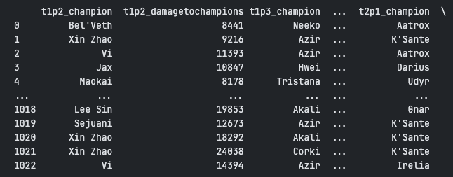
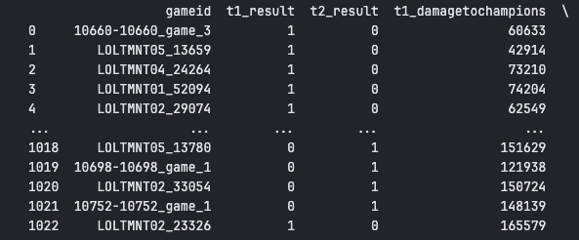
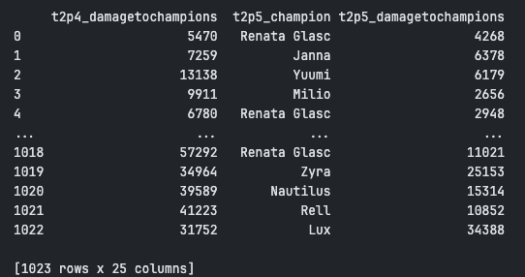
Data Preparation and Cleaning (Exploring with PandasAI)
Instead of DataFrame, uses SmartDataframe from pandasai package.
Able to clean the dataset to 25 columns.
Notes:
We also tried to explore the use PandasAI to prepare and clean the datasets.
It is able to clean the dataset to 25 columns as shown in the screenshots.
You may refer to our jupyter notebooks for more information and our thoughts on PandasAI.
I will now pass the time to Elias to talk about the first problem definition. Elias please.

Slide 11

Problem Definition #1
Analyze official competitive matches and identify the best champion class combination that will result in a win
Tasks
Perform data exploration and analysis (EDA).
Based on the observations and findings derive a conclusion.
Notes:
Thanks Brandon, I am Elias, next I will talk about the our 1st problem definition
Problem Definition 1
analyze competivite matches and identify the best champion combination that will result in a win
Perform eda and derive a conclusion base on observation and findings

Slide 12

Exploratory Data Analysis
Analyze the Team Compositions of winning teams
Observe the most optimal champion class for each role / position
Using visual representations to aid in identifying and confirming what team composition is the best
Gather findings and conclude
Notes:
For our first EDA, our objectives is to analyse the team compositions that have won a match. Observe the compositions of this winning teams and identify the best class for each role in the game. Finally gather our data and conclude what is the best team composition.

Slide 13
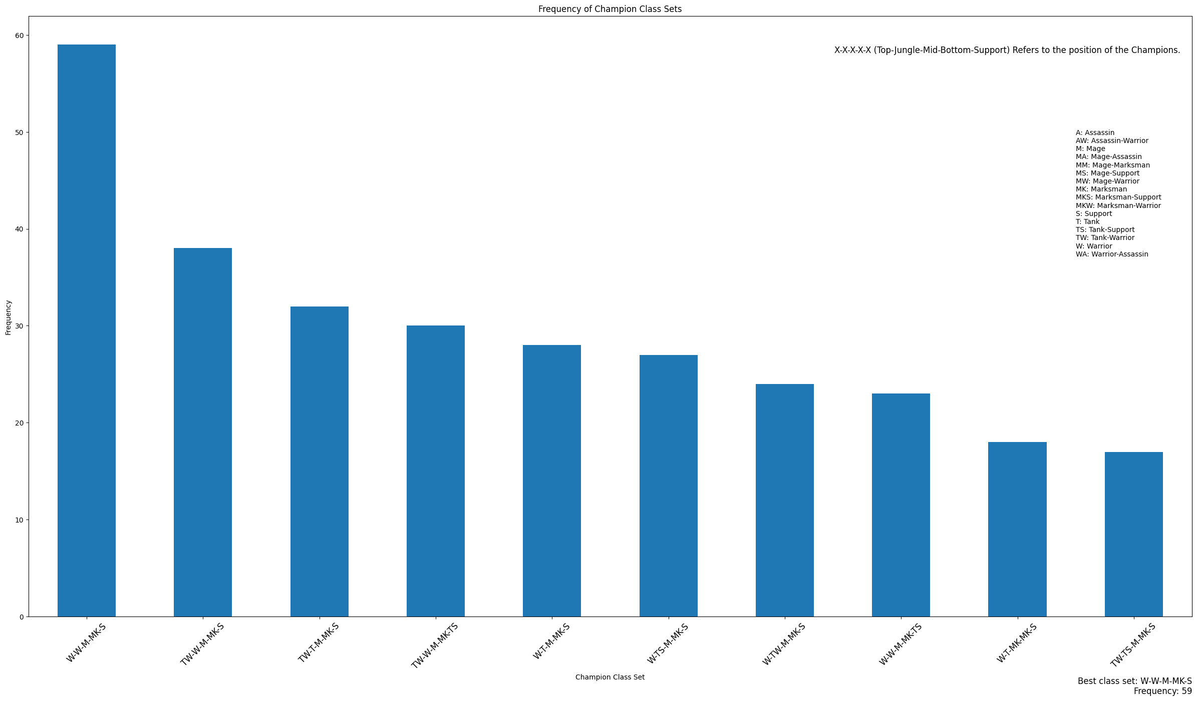
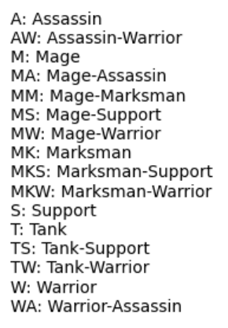
Bar Graph
Bar Graph
Notes:
Here we have a bar graph showing the class set of champion in each position
Based off the bar chart, the most frequently picked class combination is Warrior for top, warrior Jungle , Mage for mid, marksman for bottom & support for support

Slide 14
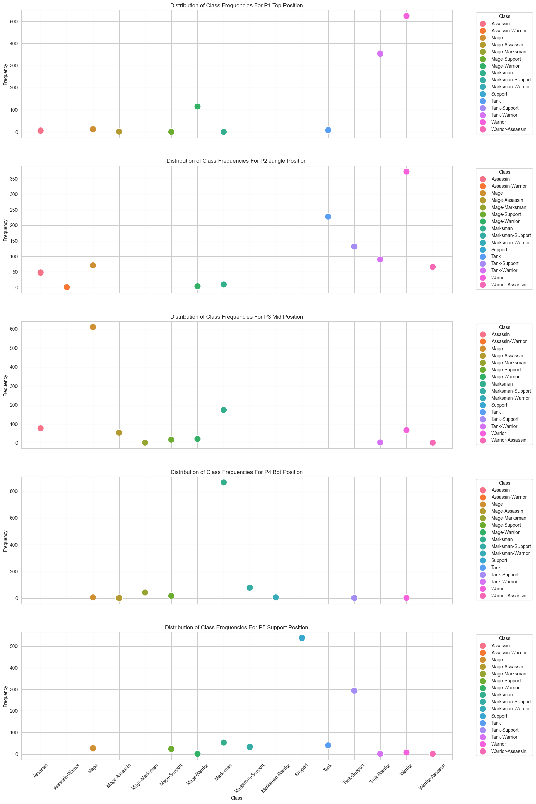
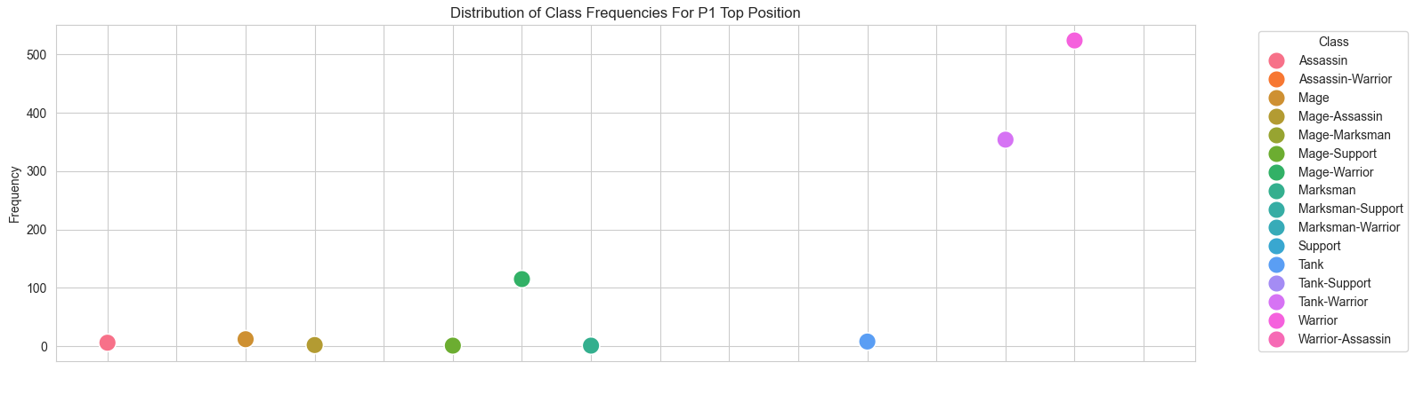
Scatter Plots
Notes:
Creating a scatter plot to get a better view of what different classes were picked for each role. To further support the best combination from the bar graph we can see that the most frequent classes selected were indeed the more popular picks when it comes to their own roles. Here is an example for the Top position.

Slide 15
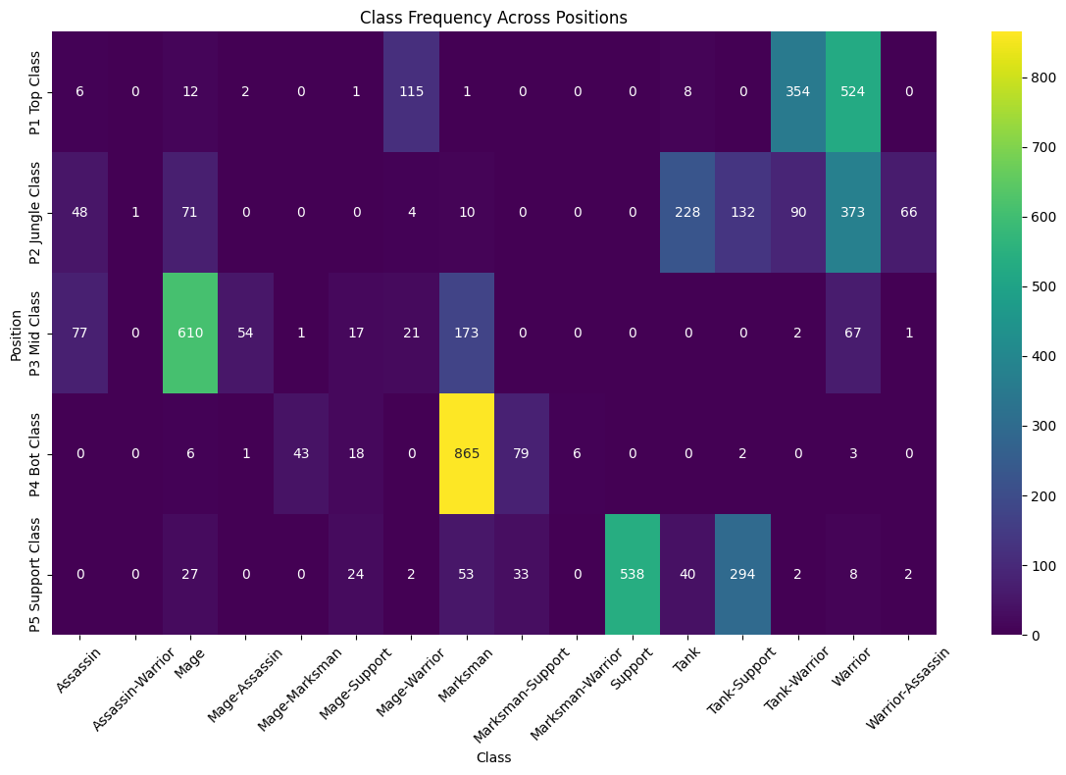
Heat Map
Notes:
To confirm our findings and get a rough overview of the best classes for each role, we plotted a heat map showcasing the distribution of each class to each position.

Slide 16
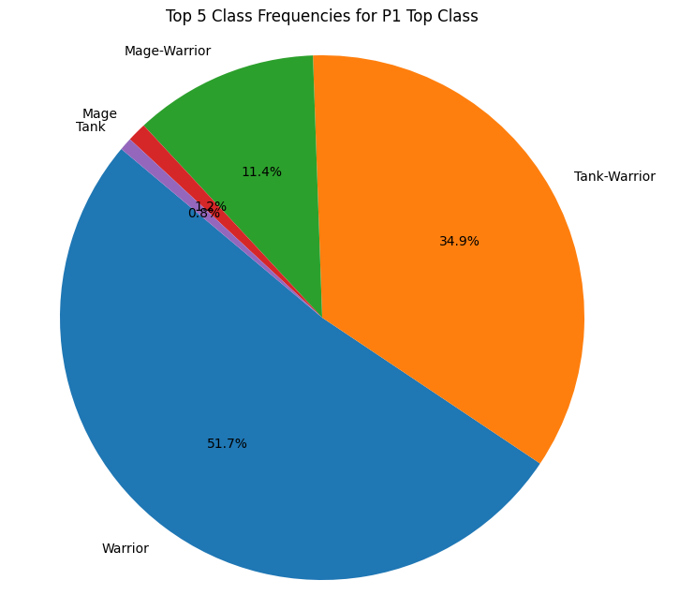
Pie Charts
Notes:
lastly, we also used a pie charts for each position to further solidify our conclusion. Here is an example for the Top position, with warrior at 51.7%

Slide 17
Top:
Warrior
Jungle:
Warrior
Mid:
Mage
Bottom & Support:
Marksmen & Support
Conclusion
Notes:
Best team composition based on our EDA is: Warrior for top, warrior Jungle , Mage for mid, marksman for bottom & support for support

Slide 18





















League Of Legends In-game Gold System
Gold is the primary in-game currency used in League of Legends match.
It represents wealth and resources accumulated by players and the team during a match.
Gold is mostly earned by killing minions (CS creep score), neutral objective monsters, enemy champions and structures such as turrets and inhibitors.
Gold can be used to purchase items that provides stat boosts, passive and active effects to enhance a champion’s abilities and performance over the course of a game, which in turn increase the chance of winning.
Notes:
Before going into our second problem definition, we would like to explain League of Legend’s in Game Gold system.
Gold is the primary in-game currency used in a league of legends match. It represents the wealth and resources accumulated by players and the team in a match.
The only way to earn gold is mostly by killing minions, neutral objective monsters, eliminating enemy champions and taking down enemy structures such as turrets and inhibitors.
This gold can be used to purchase items that can provide a massive stat boost, passive and active effects, enhancing a champion’s abilities and performance.

Slide 19
Problem Definition #2
What is the most optimal and suitable game variable in predicting the total combined gold value?
Amongst these variables Total kills, Total minion score, Neutral Objectives and Structures taken down
Tasks
Variables that mainly affect gold values are
Neutral objectives (Baron, Dragon, Herald etc.)
Kills
Total CS (Killing Minions)
Taking down enemy structures
Perform data exploration and analysis (EDA).
Machine learning
Based on the observations acquire the best variable to be used predicting the gold value.
Notes:
Problem formulation #1: What champion composition for each position will maximize the chances of winning The objective of this project is to analyze data from official competitive matches of League of Legends and identify the best combinations of champions that result in the highest win rates. By leveraging a dataset containing comprehensive information on competitive games and another dataset containing details about individual champions, the aim is to provide insights into champion synergy and strategic compositions that lead to success in professional League of Legends play.

Slide 20
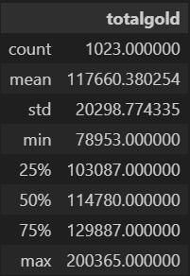
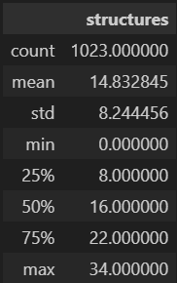
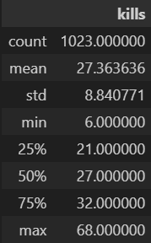
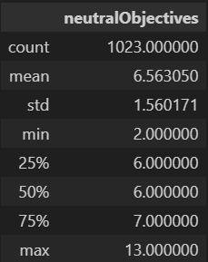
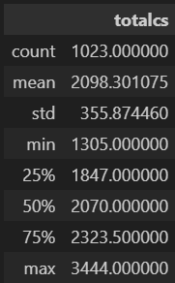
Exploratory Data Analysis
Numerical Statistics
Notes:
Here are the statistical numerical values for the variables at play.
Focusing on gold
The distribution of gold obtained appears slightly right-skewed, with more matches having gold amounts closer to the lower end of the range. However, the median and mean are relatively close, indicating that the distribution is not heavily skewed.
Overall, while the standard deviation suggests moderate variability in gold income among matches, the summary statistics indicate that gold income in League of Legends matches can vary widely, with some matches having significantly higher or lower amounts of gold obtained compared to the average. This variability could be influenced by factors such as player performance, game strategies, and in-game events.
That will be all for me, I will pass over to raj to continue the EDA

Slide 21
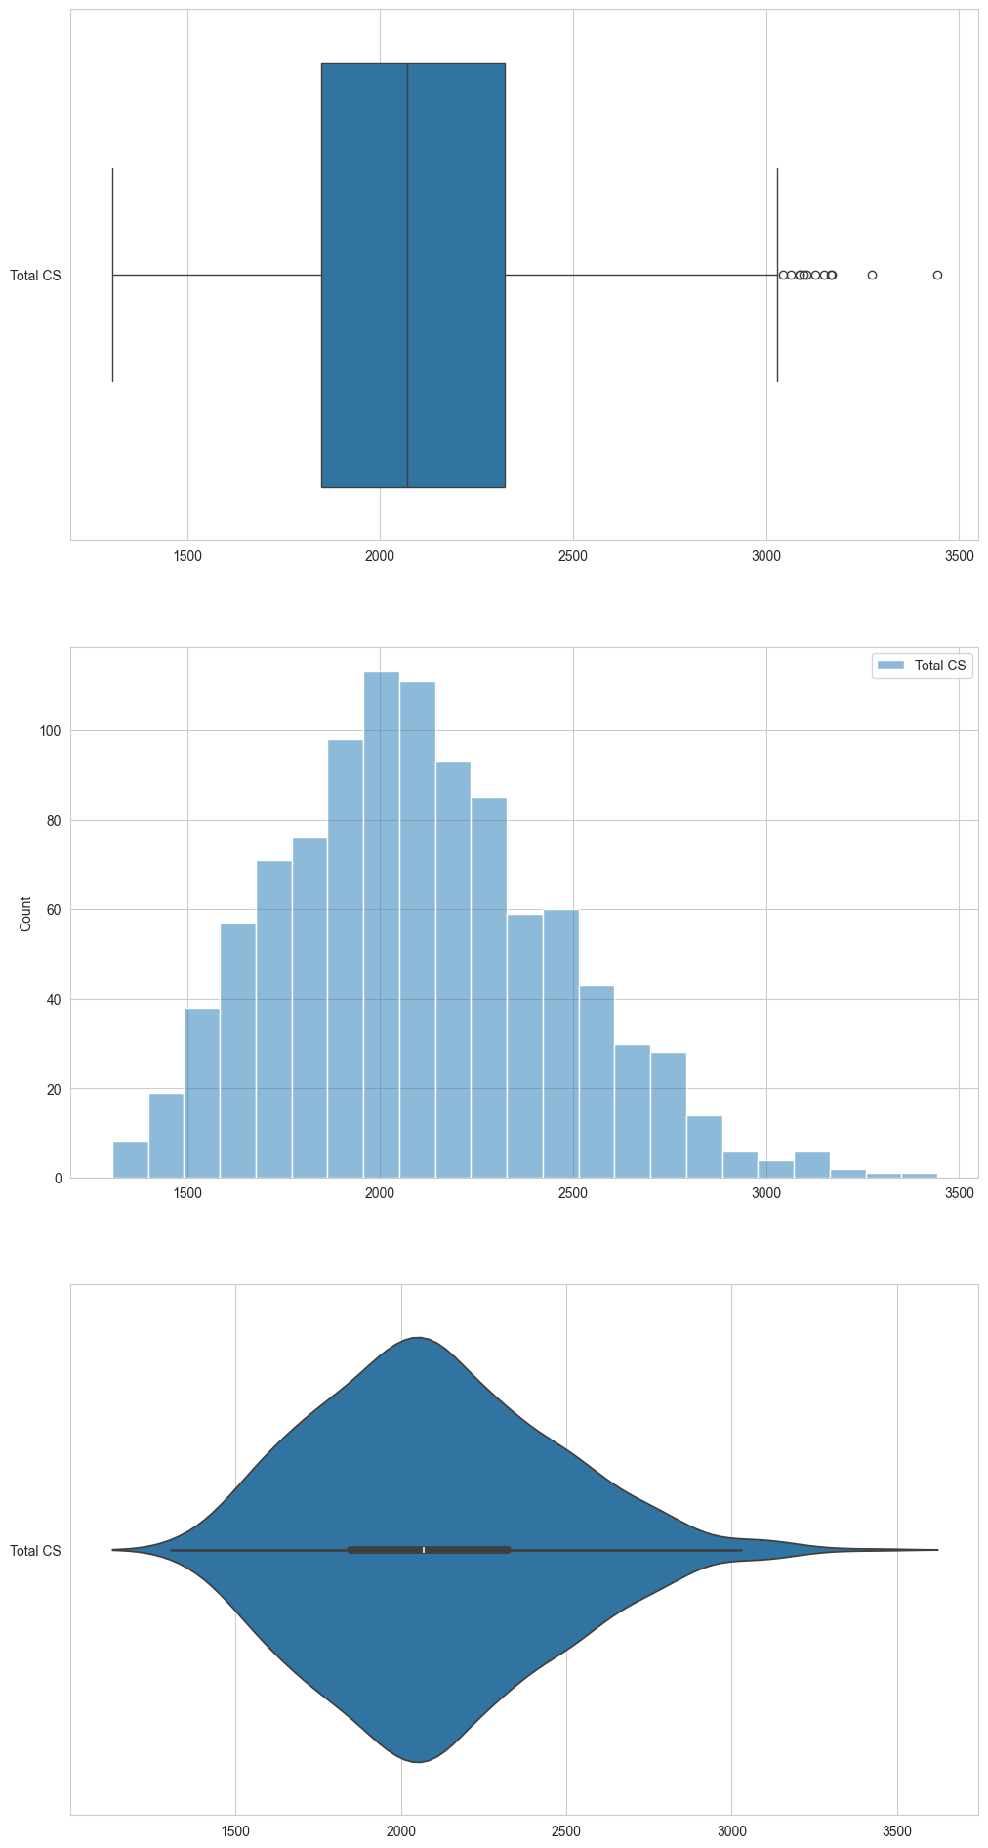
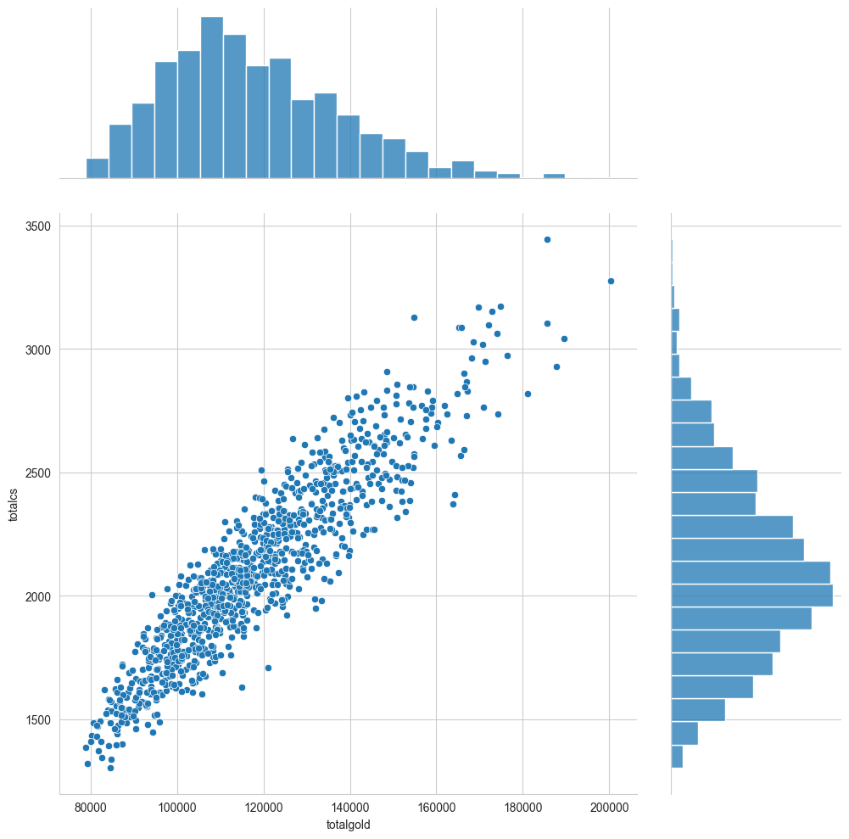
Exploratory Data Analysis
Visual Representations
Box Plot
Histogram
Joint Plot
Violin Plot
Notes:
Further visual the numerical values statistics we plotted each of their box plots, histogram and violin plots. And to compare them back to the total gold we used joint plots ->

Slide 22
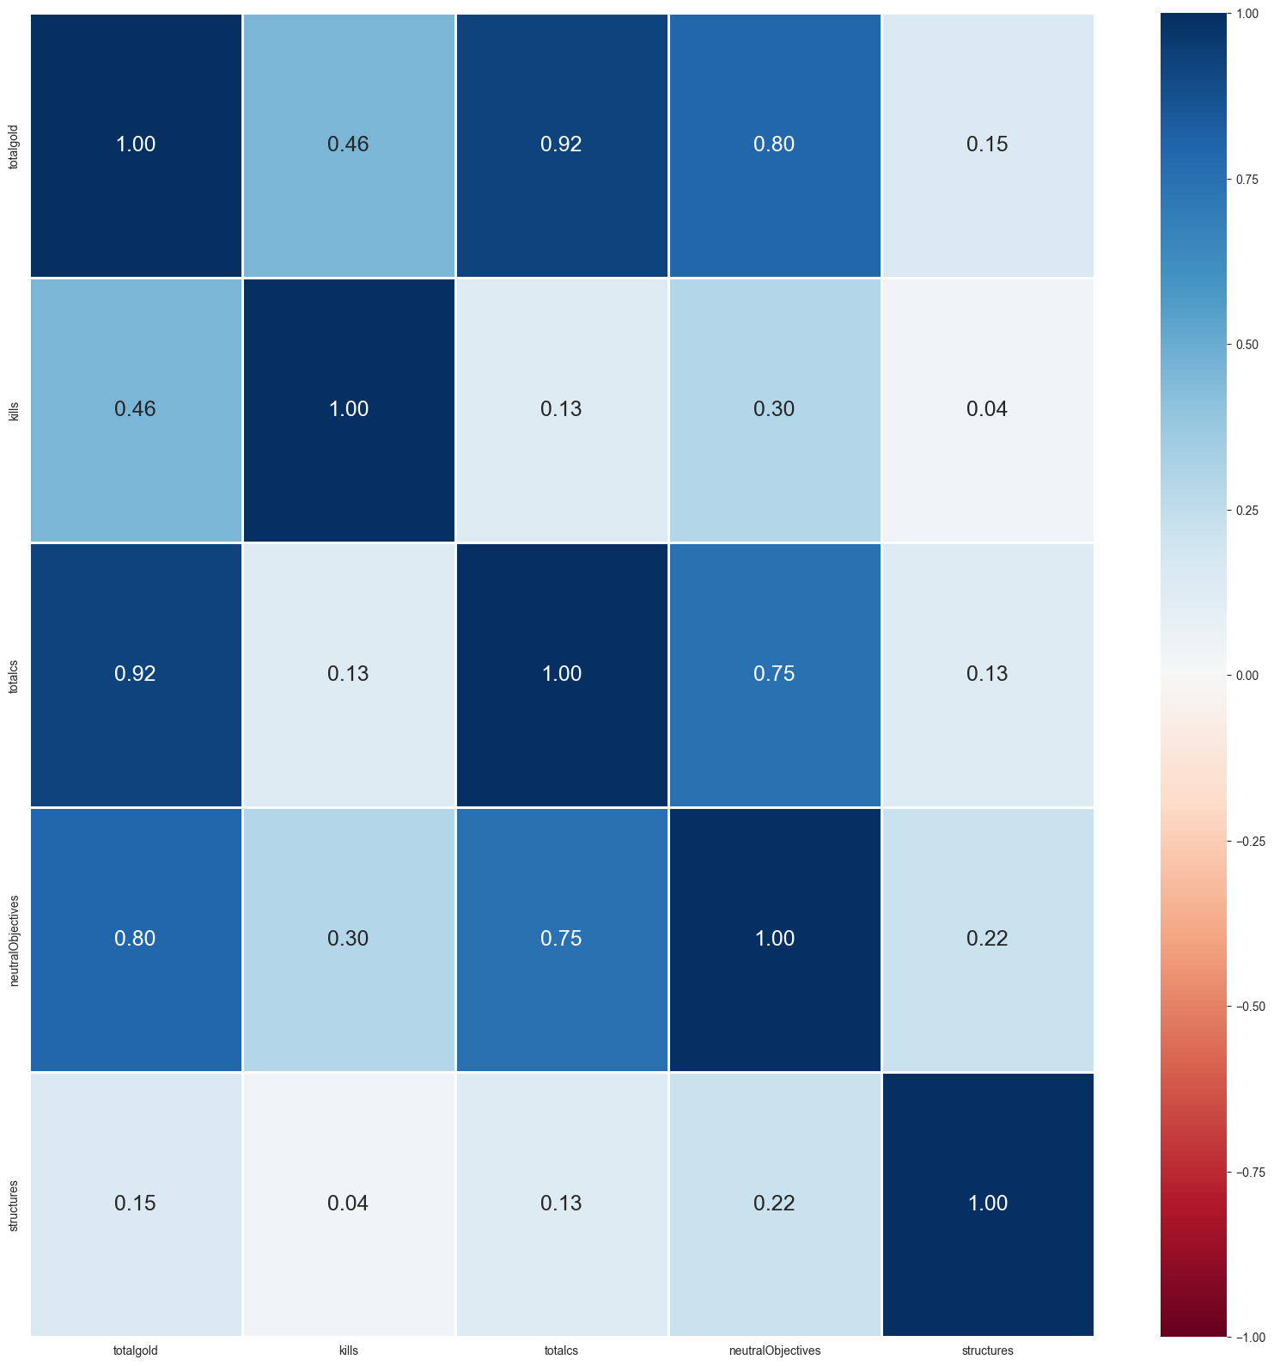
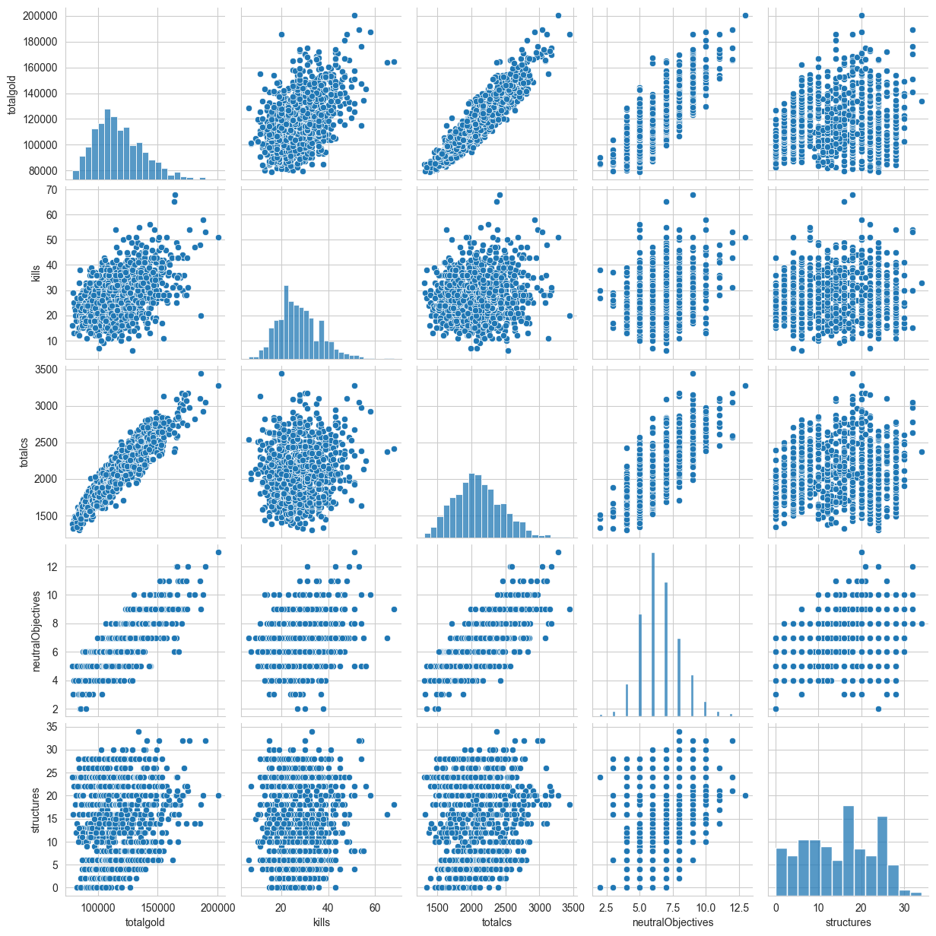
Correlation Matrix
Exploratory Data Analysis
Visual Representations
Pair plots
Notes:
Pair plots and the correlation matrix . After analyzing the

Slide 23



Best Variable TOTAL CS
Notes:
With the highest value in the correlation matrix of 0.92, a nice general and proportionate pattern in the data points found in both the pair plot and joint plot

Slide 24
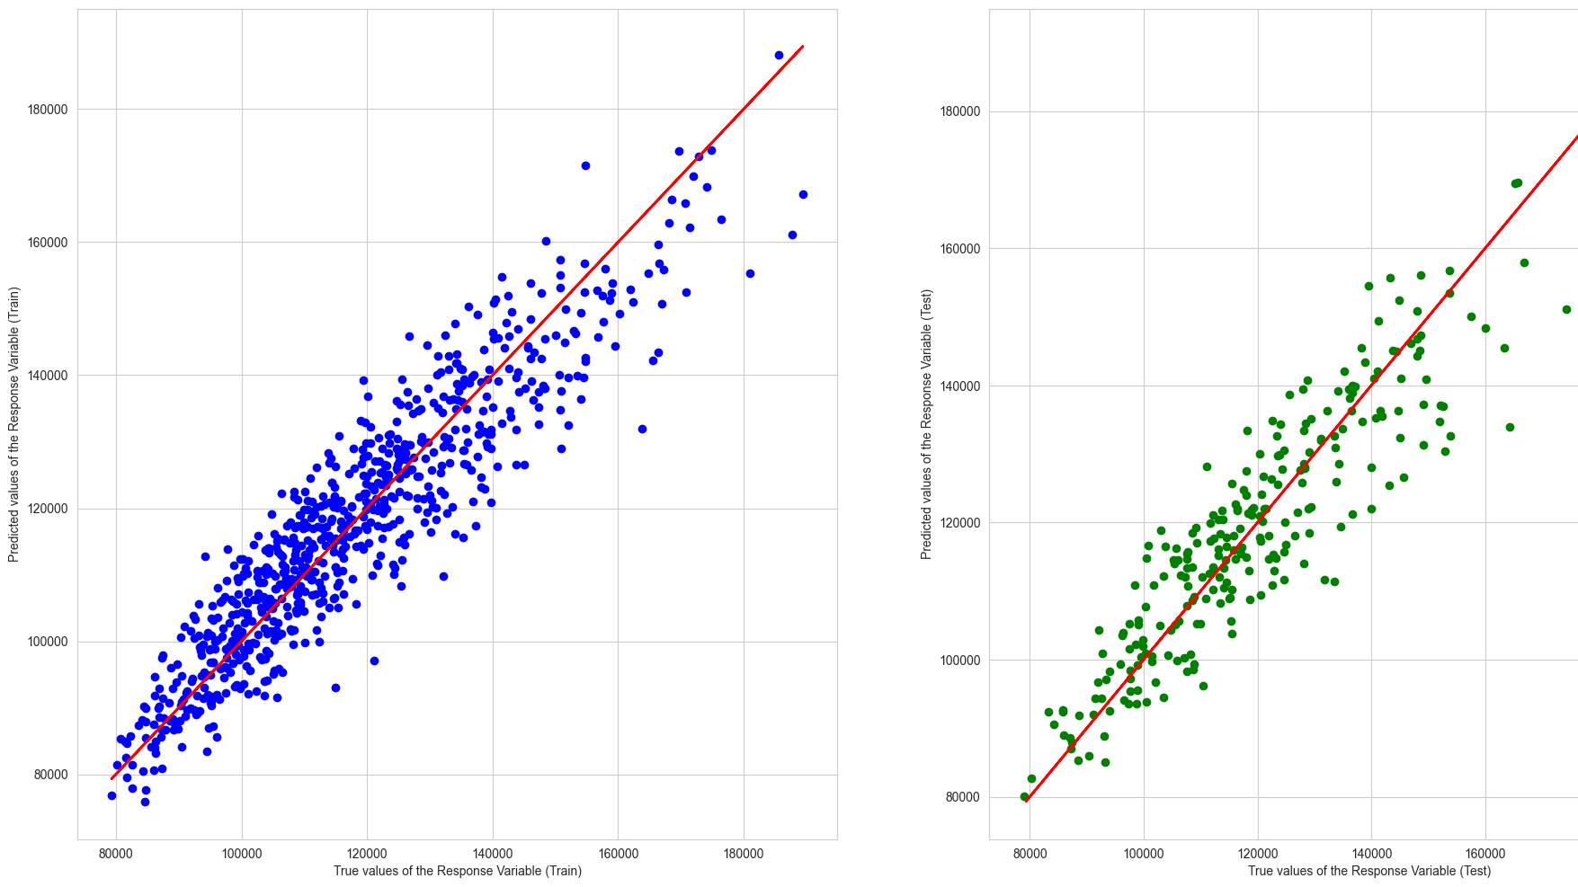
Machine Learning Linear Regression
Notes:
Analysing the pair and joint plot we can see that a linear regression machine learning model is also well suited when it comes to predicting the total gold with total cs. As you can see from the skewness line being positive almost 1-1.

Slide 25
Can we accurately predict the outcome of the match? Based on team compositions, total gold earned, kill score, creep scores, neutral objectives score, and structures taken score.
Tasks
Referencing and referring to the EDAs from problems 1 & 2.
Machine learning
Create a model using the Random Forest Tree Classifier
To train and test and accurately predict the winner of a game.
Problem Definition #3
Notes:
After going through both problems 1 & 2, we then ask ourselves if we can accurately predict the outcome of a league of legends match? Based on the team compositions, total gold earned, kill score, creep scores, neutral and structure objectives taken? We referenced our combined EDA and dataset to tackle this problem.

Slide 26
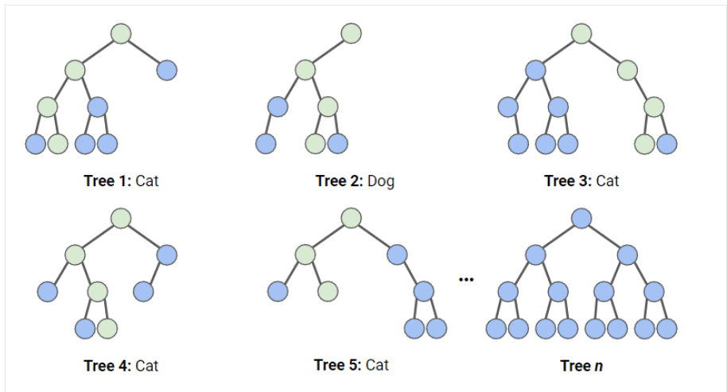
RANDOM FOREST TREE CLASSIFIER
MACHINE LEARNING
Notes:
The machine learning model we used to do this prediction is:
Random forests are a popular supervised machine learning algorithm.
Random forests are for supervised machine learning, where there is a labeled target variable.
Random forests can be used for solving regression (numeric target variable) and classification (categorical target variable) problems.
Random forests are an ensemble method, meaning they combine predictions from other models.
Each of the smaller models in the random forest ensemble is a decision tree.

Slide 27
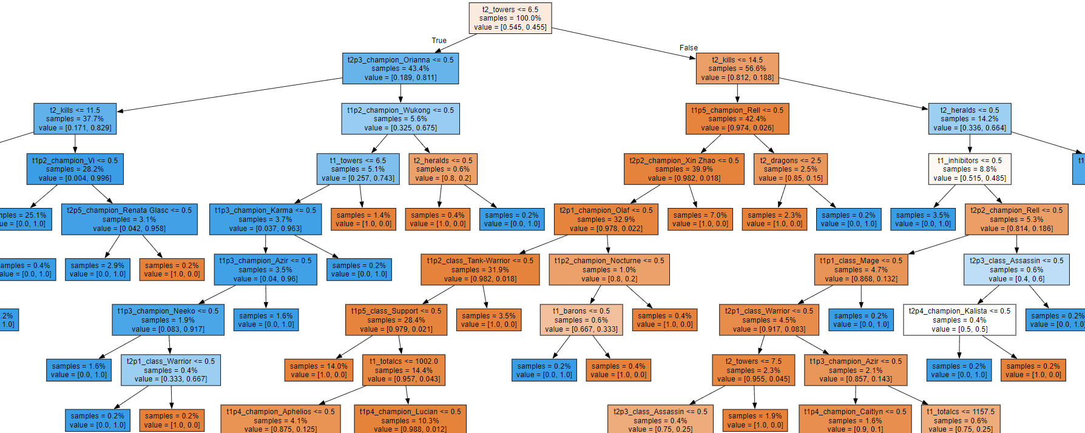
Notes:
In a random forest classification, multiple decision trees are created using different random subsets of the data and features. Each decision tree is like an expert, providing its opinion on how to classify the data. Predictions are made by calculating the prediction for each decision tree, then taking the most popular result. (For regression, predictions use an averaging technique instead.)

Slide 28
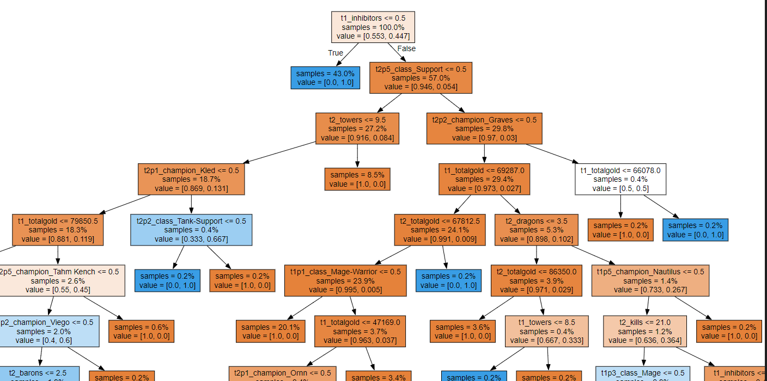
Notes:
In a random forest classification, multiple decision trees are created using different random subsets of the data and features. Each decision tree is like an expert, providing its opinion on how to classify the data. Predictions are made by calculating the prediction for each decision tree, then taking the most popular result. (For regression, predictions use an averaging technique instead.)

Slide 29
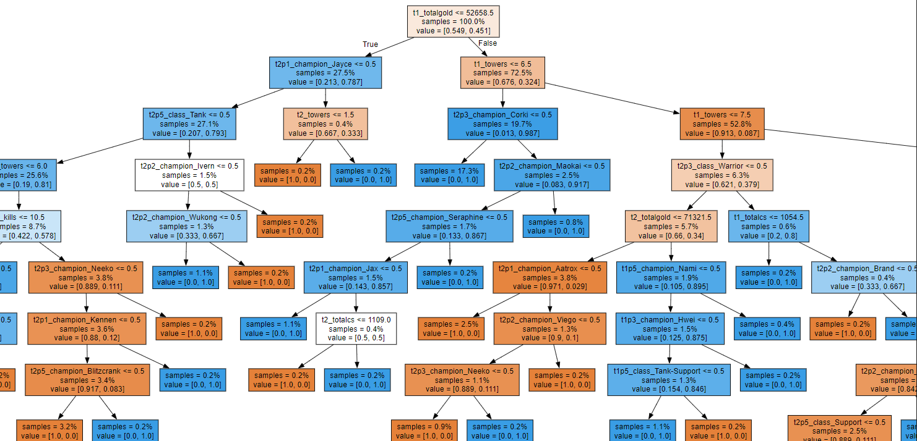

Slide 30

Hyperparameter tuning
n_estimators
Number of decision trees in the forest.
max_depth
The maximum depth of each decision tree in the forest
Randomized Search CV/Grid Search CV
Find the best variable, number of depth and number of trees,
Notes:
Hyperparameter tuning is a method to adjust and customize the performance of a model.
n_estimators: the number of decision trees in the forest. I
max_depth: the maximum depth of each decision tree in the forest
Randomized Search:
Suitable for larger hyperparameter spaces.
May not guarantee finding the optimal combination, but it's more efficient in many cases.
Grid Search
Exhaustively searches through all possible combinations of hyperparameters defined in a grid.
Suitable for smaller hyperparameter spaces where it's feasible to explore all combinations.
Guarantees finding the optimal combination if it exists within the search space.

Slide 31
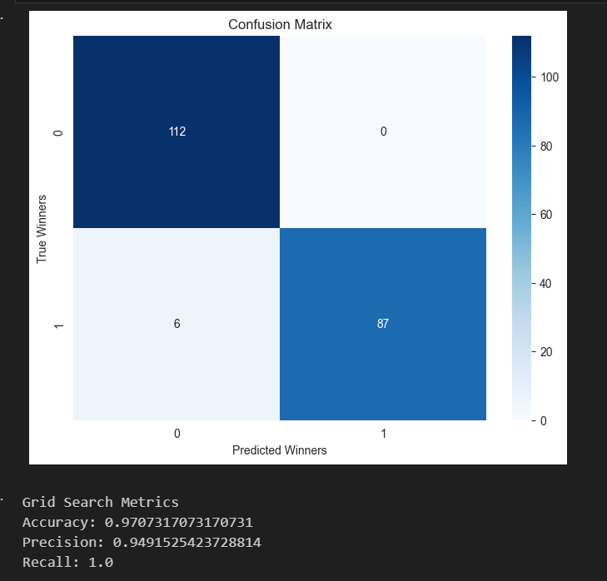
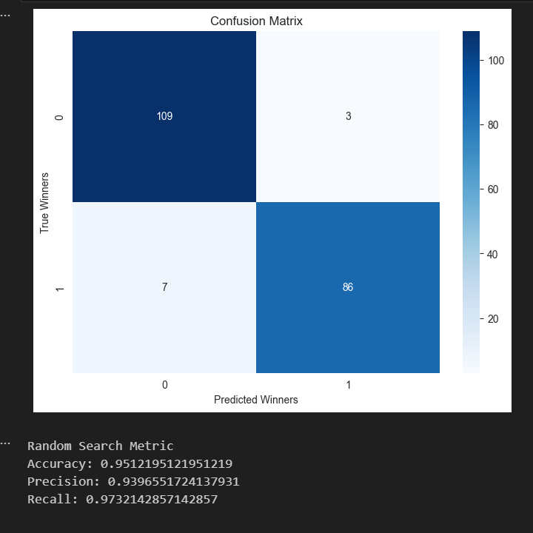
Evaluation Matrics
Confusion Matrix
Grid Search Metrics
Accuracy: 0.9707317073170731 Precision: 0.9491525423728814 Recall: 1.0
Notes:
After adjusting the parameters this is the metrics that came out. Accuracy - 97% means that approximately 96.58% of the predictions made by the model were correct
Precision - 94% means that approximately 94.12% of the instances predicted as positive by the model were actually positive
Recall - 100% means that the model correctly identified all positive instances in the data

Slide 32

Conclusion
Notes:
With the given dataset and variables that we extracted. We can predict the outcome using a combination of random tree classifier and a grid search to hyper tune our parameters leading to the best prediction; with this metrics we have obtained we are confident that it is accurate in predicting the winner of a game.

Slide 33
Reference
League of legends images - https://www.pngwing.com/en/search?q=league+of+legends
League of Legends title banner - https://www.leagueoflegends.com/en-sg/
Random forest tree classifier – https://www.datacamp.com/tutorial/random-forests-classifier-python

